Slide 1
The lecture 9
Marketing research using digital technologies

Slide 2
Objectives
To describe the basic steps in conducting marketing research
To explore the fundamental methods of gathering data for marketing research
To describe the nature and role of information systems in marketing decision making
To understand how such tools as databases, decision support systems, and the Internet facilitate marketing research
To identify key ethical and international considerations in marketing research

Slide 3
Chapter Outline
The Importance of Marketing Research
The Marketing Research Process
Using Technology to Improve Marketing Information Gathering and Analysis
Issues in Marketing Research

Slide 4
The Importance of Marketing Research
Marketing Research
  The systematic design, collection, interpretation, and reporting of information to help marketers solve specific marketing problems or take advantage of marketing opportunities

Slide 5
The Importance of Marketing Research (cont’d)
Benefits of Marketing Research
  Helps firms stay in touch with customers’ changing attitudes and purchase patterns
  Assists in better understanding market opportunities
  Determines the feasibility of a particular marketing strategy
  Aids in the development of
  marketing mixes to match
  the needs of customers
  Improves marketer’s ability
  to make decisions

Slide 6
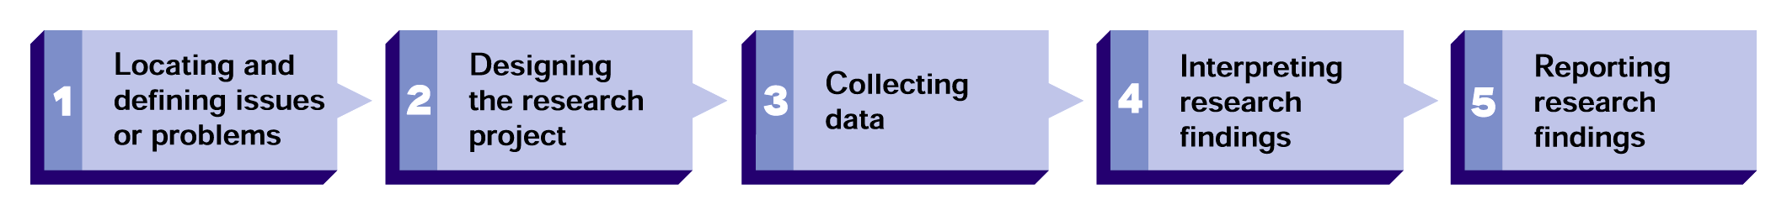
The Five Steps of the Marketing Research Process
FIGURE 7.1

Slide 7
The Marketing Research Process
Locating and Defining Problems or Research Issues
  Focusing on uncovering the nature and boundaries of a situation or question related to marketing strategy or implementation
    Departures from normal or expected marketing results
    Biases in marketing information that distort its meaning
    Evidence of possible or potential market opportunities

Slide 8
The Marketing Research Process (cont’d)
Designing the Research Project
  Research design
    An overall plan for obtaining the information needed to address a research problem or issue
  Hypothesis
    An informed guess or assumption about a certain problem or set of circumstances
    Accepted or rejected hypotheses act as conclusions for the research effort

Slide 9
The Marketing Research Process
Types of Research
  Exploratory research
    Research conducted to gather more information about a problem or to make a tentative hypothesis more specific
  Descriptive research
    Research conducted to clarify the characteristics of certain phenomena to solve a particular problem
  Causal research
    Research in which it is assumed that a particular variable X influences a variable Y

Slide 10
The Marketing Research Process
Research Reliability and Validity
  Reliability
    A condition existing when a research technique produces almost identical results in
    repeated trials
  Validity
    A condition existing
    when a research method
    measures what it is
    supposed to measure

Slide 11

The Marketing Research Process
Collecting Data
  Types of data
    Primary data: data observed and recorded or collected directly from
    respondents
    Secondary data: data
    complied both inside and
    outside the organization
    for some purpose other
    than the current
    investigation

Slide 12
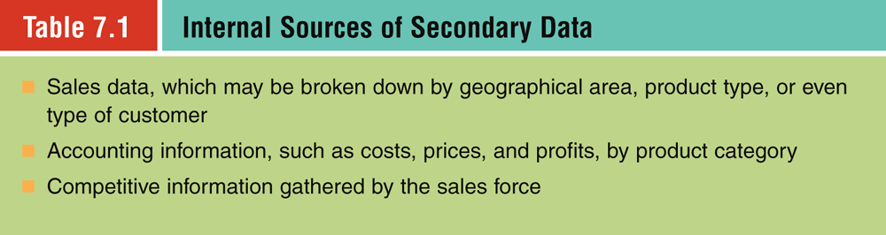

Slide 13
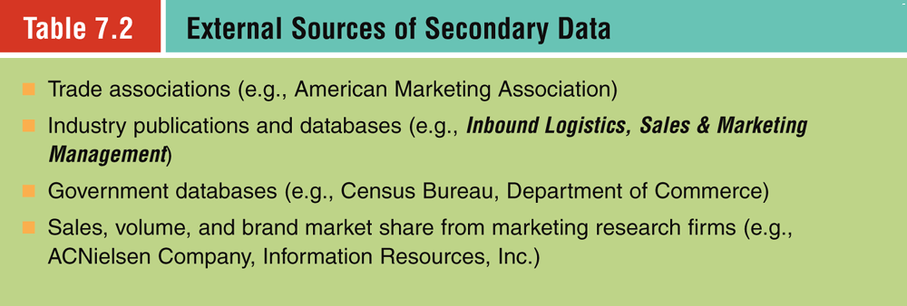

Slide 14
The Marketing Research Process
Methods of Collecting Primary Data
  Sampling
    Population—all the elements, units, or individuals of interest to researchers for specific study
    Sample—a limited number of units chosen to represent the characteristics of a total population
  Types of sampling
      Probability—each element has an known chance for study
      Random—each element has an equal chance for study
      Stratified—study population divided into like groups
      Nonprobability: element’s likelihood of study is unknown
      Quota: population is grouped and elements are arbitrarily chosen

Slide 15
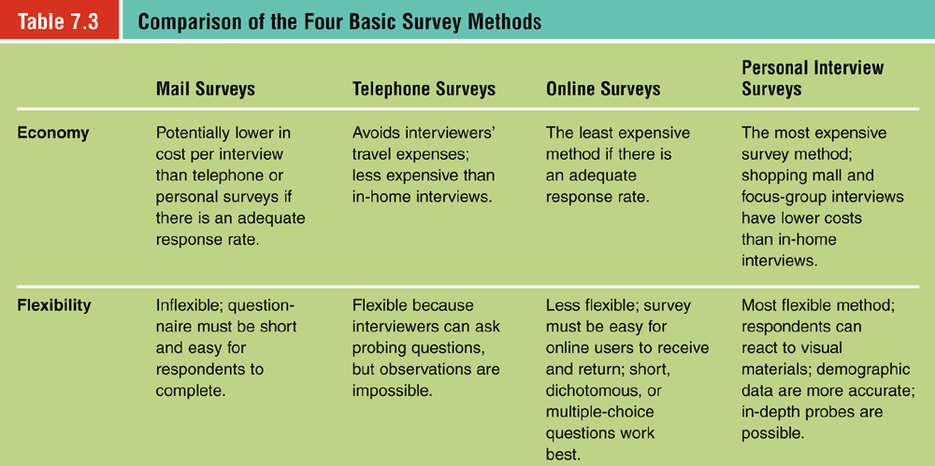

Slide 16
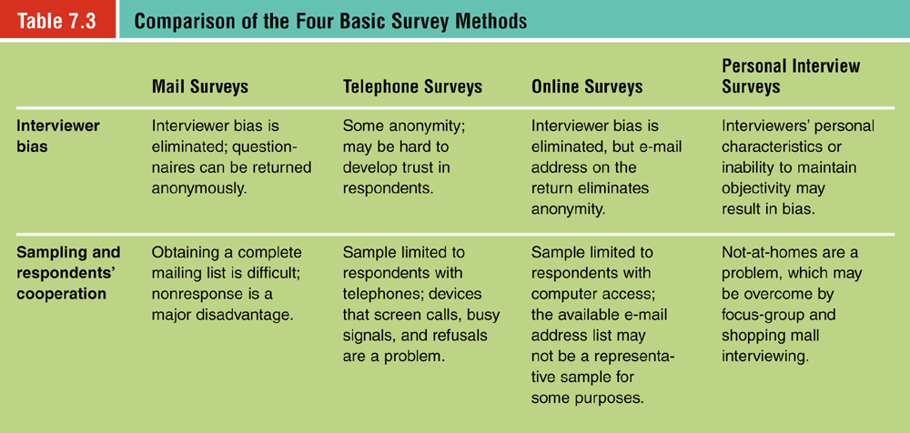

Slide 17

The Marketing Research Process
Basic Survey Methods
  Mail survey
  Telephone survey
  Online survey
  Personal interview survey
    In-home (door-to-door) interview
    Focus-group interview
    Telephone depth interview
    Shopping mall intercept interviews
    On-site computer interviews

Slide 18
The Marketing Research Process
Questionnaire Construction
  Open-ended question
    Question which invites the respondent to answer as their own interests or personal subjectivity dictates
  Dichotomous question
    Question which to which the respondent can make only an either/or or yes/no response
  Multiple-choice question
    Question asks the respondent to choose a response from a fixed set of responses
Observation Methods
Experimentation

Slide 19
The Marketing Research Process (cont’d)
Observation (for Data Collection) Methods
  Direct contact with subject is avoided to reduce possible awareness of observation process.
  Physical conditions, subject actions, and demographics are noted.
  Observations may be combined with same subject interviews.
  Data gathered may be influenced by observer bias.

Slide 20
The Marketing Research Process (cont’d)
Experimentation
  A research method that attempts to maintain (control) certain variables while measuring the effects of experimental (uncontrolled) variables
    Independent variable: acts on the dependent variable
    Dependent variable: is affected by variations in the independent variale

Slide 21
Interpreting Research Findings
Statistical Interpretation
  Analysis of survey data to determine what is typical or what deviates from the average that indicates:
    How widely the responses vary
    How the responses are distributed
    Which hypotheses are supported
    Which hypotheses are rejected
    Whether construction errors have invalidated the survey’s results

Slide 22
Interpreting Research Findings (cont’d)
Reporting Research Findings
  Take an objective look at survey findings
    Report deficiencies and reasons for
    deficiencies
  Prepare a formal, written document
    Summary and recommendations
      Short, clear, and simply expressed for executives
    Technical report
      Contains more detailed information about research methods and procedures and important data gathered

Slide 23
Using Technology to Improve Marketing Information Gathering and Analysis
Marketing Information Systems
  Marketing Information System (MIS)
    A framework for the management and structuring of information gathered regularly from sources inside and outside
    an organization

Slide 24
Using Technology to Improve Marketing Information Gathering and Analysis (cont’d)
Databases
  Database
    A collection of information arranged for easy access
    and retrieval
  Single-source data
    Information provided by
    a single marketing
    research firm

Slide 25
Using Technology to Improve Marketing Information Gathering and Analysis (cont’d)
Marketing Decision Support Systems (MDSS)
  Customized computer software that aids marketing managers in decision making
    Capability to create market models based on changes in marketing variables
    Artificial Intelligence (AI) assists
    in customer support

Slide 26
Using Technology to Improve Marketing Information Gathering and Analysis (cont’d)
The Internet and Online Information Services
  Ease of information dissemination
  Ease of information
  accessibility (intranets)
  Access to customer data
  (data mining websites)
  Subscription information
  services on Web

Slide 27
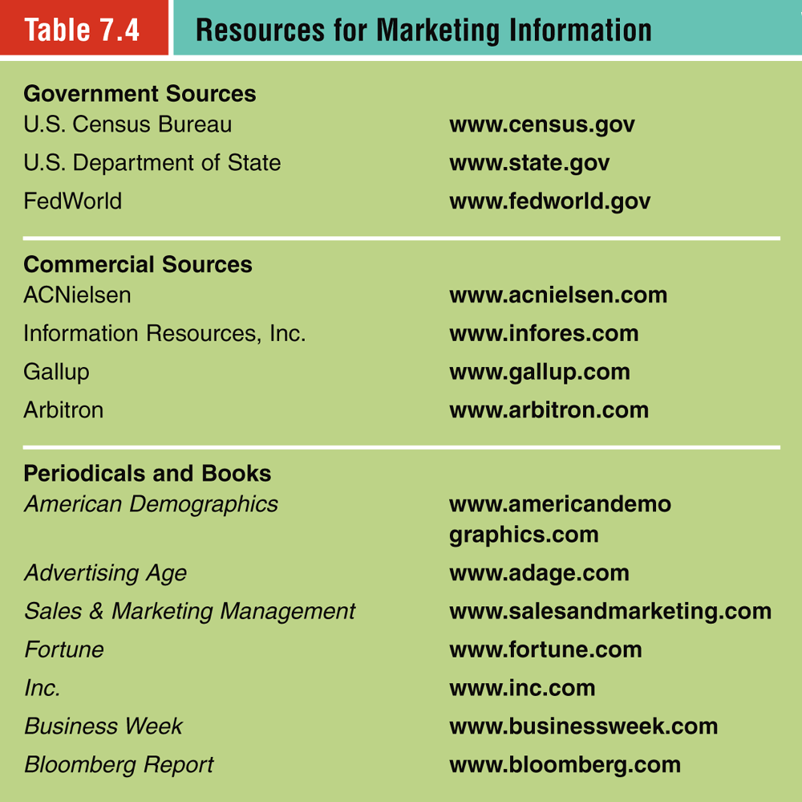

Slide 28
Issues in Marketing Research
The Importance of Ethical Marketing Research
  Ethical questions affect:
    The reliability of the research
    The researcher–marketing
    manager relationship
    The nature of marketing
    managers’ decisions

Slide 29
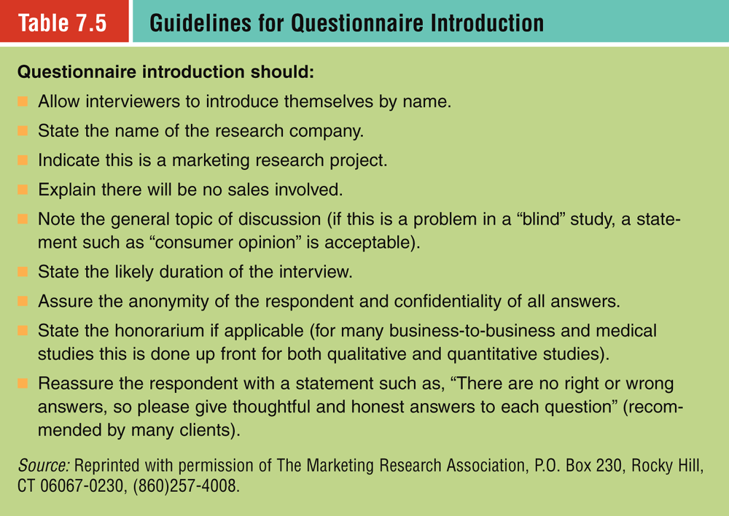

Slide 30
Issues in Marketing Research
International Issues in Marketing Research
  Modification of data-gathering methods to account for regional differences
  Use of two-pronged approach to international marketing research
    Detailed search for and analysis of secondary data
    Field research to refine firm’s understanding of how local environment will shape/restrict data-gathering about customer needs and preferences

Slide 31
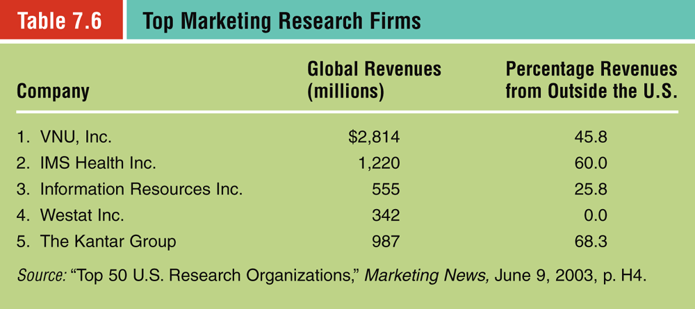

Slide 32
After reviewing this chapter you should:
Know the basic steps in conducting marketing research.
Be familiar with the fundamental methods of gathering data for marketing research.
Be able to describe the nature and role of information systems in marketing decision making.
Understand how such tools as databases, decision support systems, and the internet facilitate marketing research.
Be able to identify key ethical and international considerations in marketing research.

